Slide 1
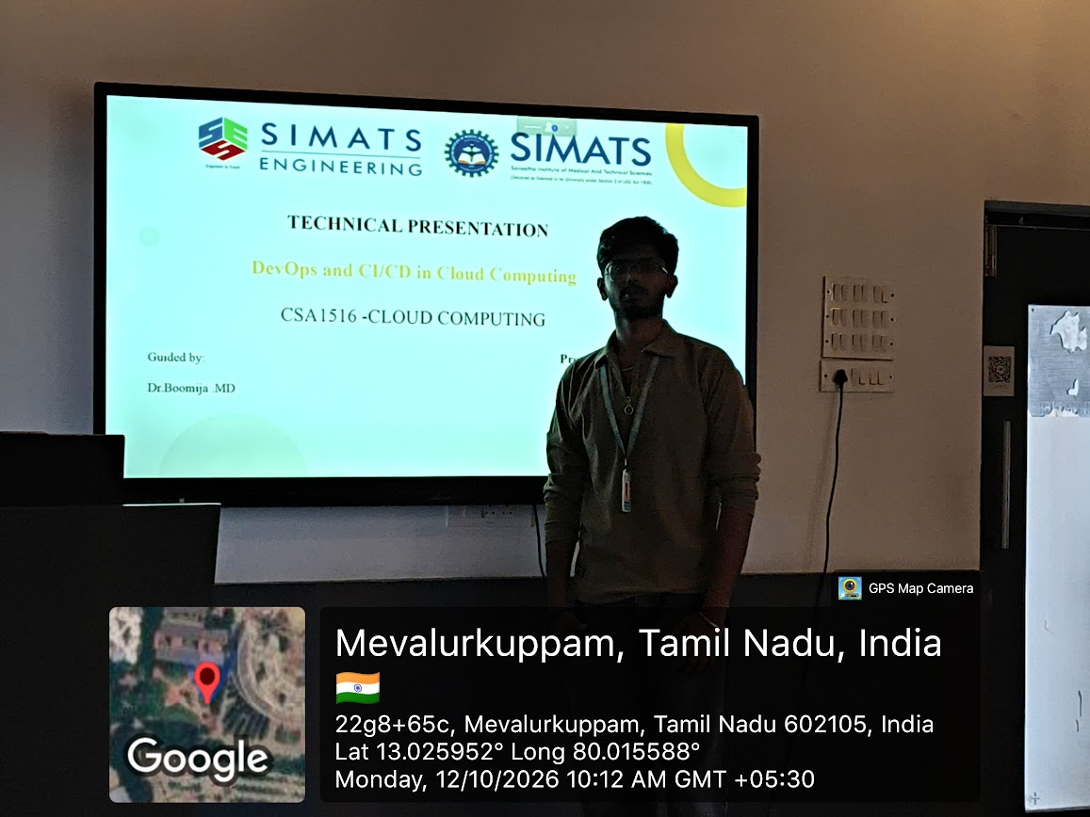

Slide 2

TECHNICAL PRESENTATION
DevOps and CI/CD in Cloud Computing
CSA1516 -CLOUD COMPUTING AND BIG DATA ANALYTICS
Guided by:
Dr.Boomija .MD
Presented by:
Tharunkumar.S[CSE department,2nd year[192511416]

Slide 3
DevOps: Why It Matters
• Connects development and IT operations
• Automates repetitive software delivery tasks
• Main objective of Devops:Improved collaboration ,speed, software quality and reliability
• CALMS: Culture • Automation • Lean • Measurement • Sharing
Key idea: DevOps is a culture, not a single tool.
2
Notes:
~35 seconds: Define DevOps and briefly explain CALMS.

Slide 4
CI/CD Architecture
单击此处编辑母版文本样式
二级
三级
四级
五级
CODE
Git push
BUILD
Compile / package
TEST
Automated checks
DEPLOY
Cloud release
MONITOR
Logs & metrics
→
→
→
→
• CI: Integrate code, build it, and test automatically
• Continuous Delivery: Keep changes ready for release
• Continuous Deployment: Release passing changes automatically
• Failed checks stop the pipeline before release
3
Notes:
~65 seconds: Walk through the five boxes; distinguish delivery from deployment.

Slide 5
GitHub Actions: A Real Example
• Example: A developer updates a React website
• A Git push triggers a workflow stored in .github/workflows/
• Checkout → Install dependencies → Test → Build
• A separate deployment step publishes to cloud hosting
• Failures are reported before deployment
GitHub Push
Actions CI
Cloud Deploy
→
→
4
Notes:
~70 seconds: Describe GitHub Actions workflow; explain deployment is separately configured.

Slide 6
Safer Releases: Blue-Green & Canary
BLUE–GREEN
Old version runs while new version is tested
CANARY
New version first reaches a small user group
• Blue-Green: Switch traffic after verifying the new version
• Canary: Increase rollout gradually if performance is healthy
• Both reduce release risk and support quicker recovery
5
Notes:
~50 seconds: Compare blue-green and canary with simple examples.

Slide 7
DevSecOps & Cloud Reliability
• DevSecOps: Include security checks in the CI/CD pipeline
• Docker: Package applications and dependencies in containers
• Kubernetes: Manage container deployment and scaling
• Monitoring: Track errors, performance, logs, and alerts
• Goal: Secure, stable, and repeatable releases
6
Notes:
~45 seconds: Explain security, Docker, Kubernetes and monitoring.

Slide 8
Future of DevOps & Conclusion
• GitOps: Manage deployment configuration through Git
• AI-assisted operations: Detect anomalies and investigate failures
• Platform engineering: Provide reusable deployment tools
• CI/CD + cloud infrastructure enable frequent, reliable releases
DevOps = Culture | CI/CD = Automation | Cloud = Infrastructure
7
Notes:
~35 seconds: Mention trends and finish with the takeaway.

Slide 9
THANK YOU

